Slide 1
CGNRC Meeting
7-8 Sep 2022

Slide 2
Military Personnel (CG-13)
CG-13
Thanks so much for making time for important event
Thanks for all you do for the CG and our Retirees
Thanks to Bob Hinds for putting this together
2 full days of action
Special Thanks to those supporting
RADM Hathaway, MCPO Pierce, CWO Hinds
Interested in your feedback

Slide 3
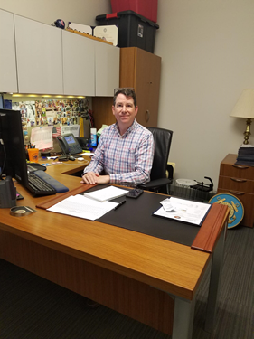
Military Personnel (CG-13)
CG-1331 (Policy Development)
Workforce Planning Team (Active, Reserve)
Career Flexibility Program
Tattoo and Body Piercing
CG-1332 (Pay and Compensation)
JTR Change, allows more flex for final HHG moves upon retirement
JTR Change, increased fuel reimbursement rate for PCS/TDY (01July)
Govt Charge Card can now be used for (40%) of PCS costs (PPM)

Slide 4
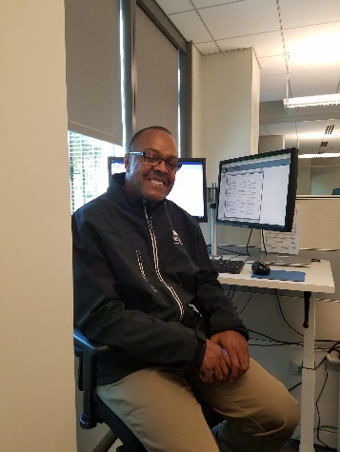
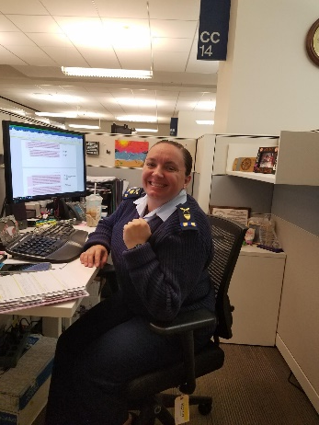
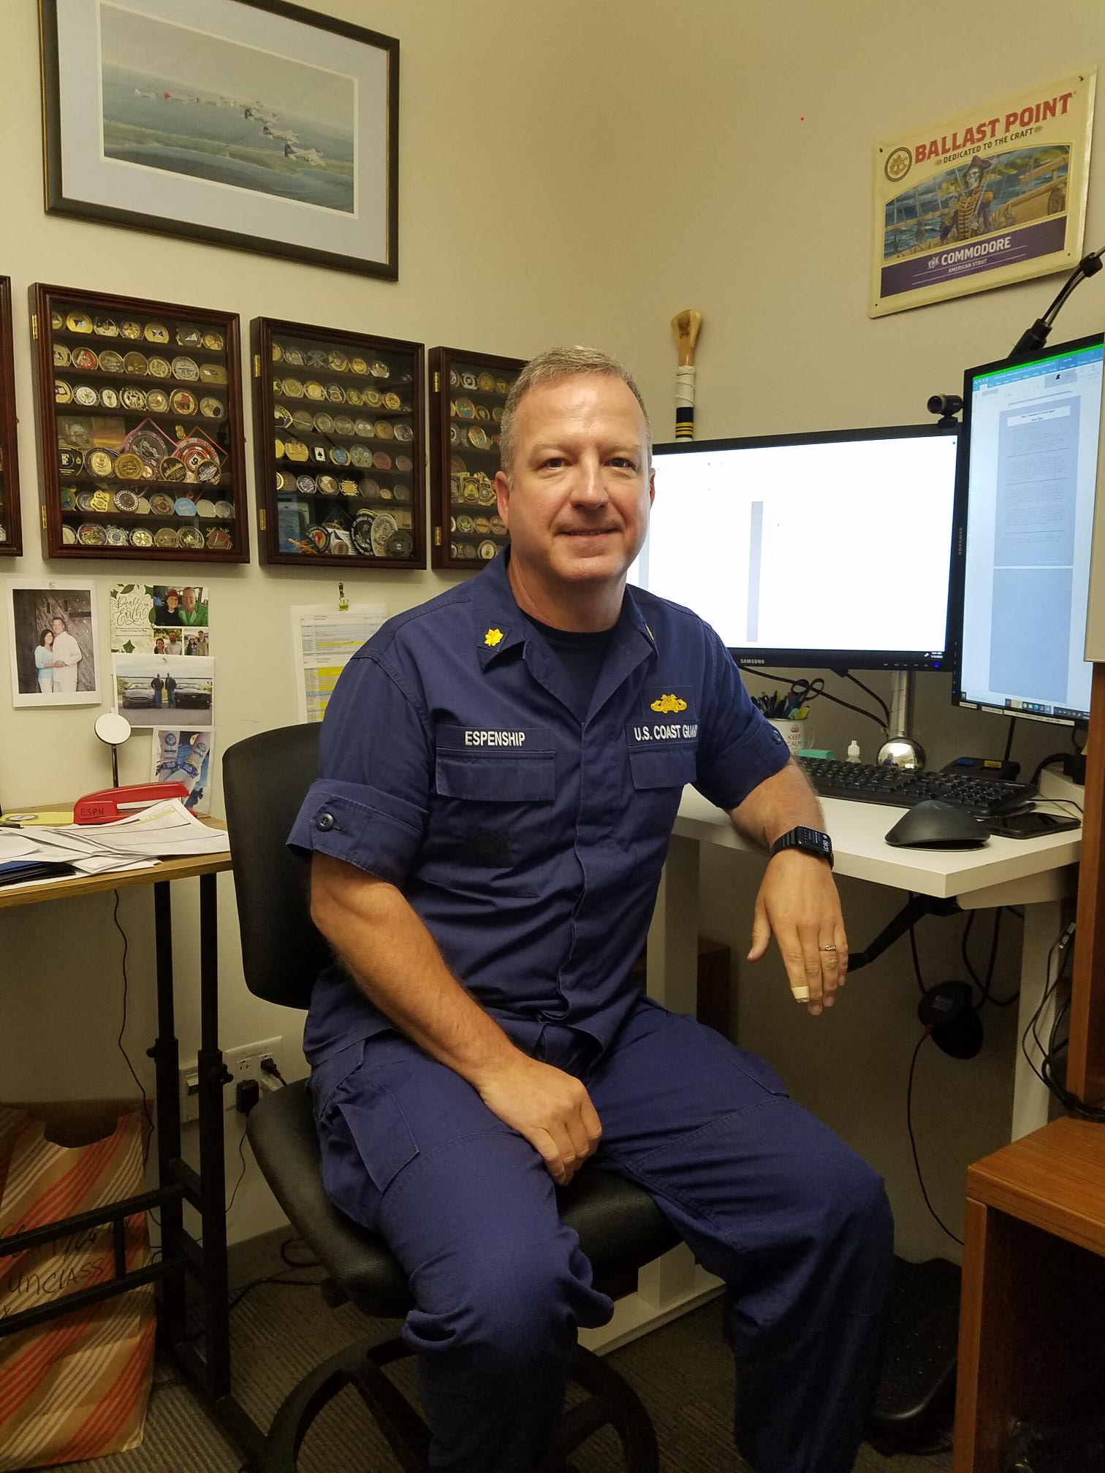
Military Personnel (CG-13)
CG-1333 (Housing)
Leased housing policy expanded to be more flexible
Housing Guide published
Safe Homes Initiative SITREP III
CG-1334 (Policy Sustainment)
Drug and Alcohol Policy update
Religious Accommodation Processing
CG-1335 (Retiree Affairs)
The Long Blue Line, Summer (July)
CG National Retiree Council Meeting, 7-8 Sep

Slide 5
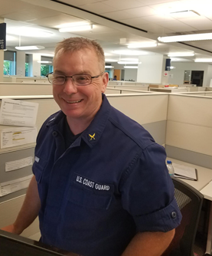
Military Personnel (CG-13)
Arrivals
CAPT Monique Roebuck
CWO Jeremy Hahn
YNCS Jennifer Hassan
CWO Tais Dominguez
CWO Jennifer Cockram
Departures
CWO Tim “Tip Top” Tipton
LT Dillion Sapp
CWO Jeremy Hahn

Slide 6
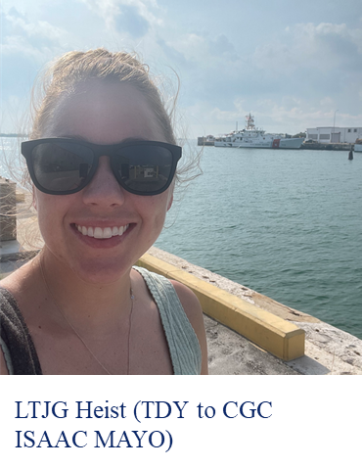
Military Personnel (CG-13)
Operational Highlight:
LTJG Madison “Maddie” Heist is currently deployed with CGC ISAAC MAYO in D7. She qualified as an Inport and Underway Officer of the Deck and has been involved in several successful migrant operations.

Slide 7
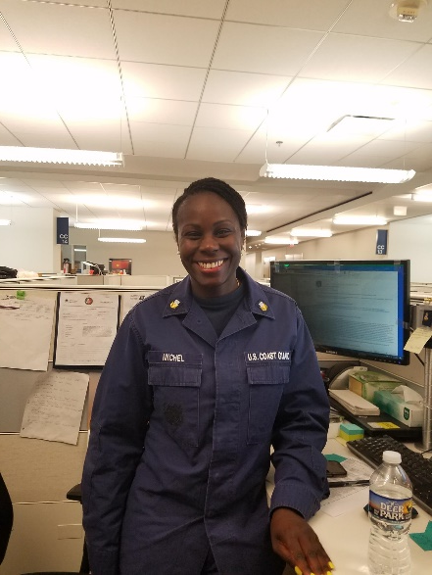
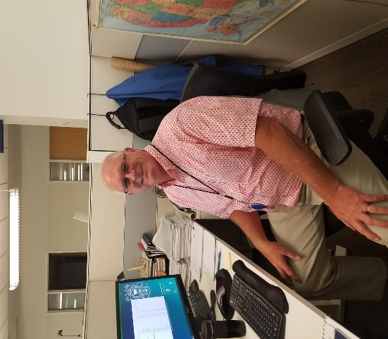
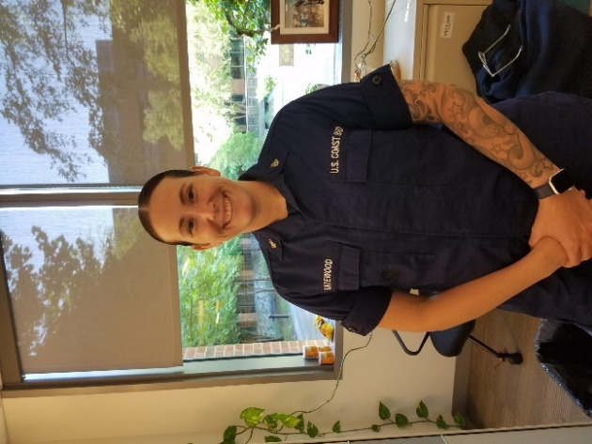
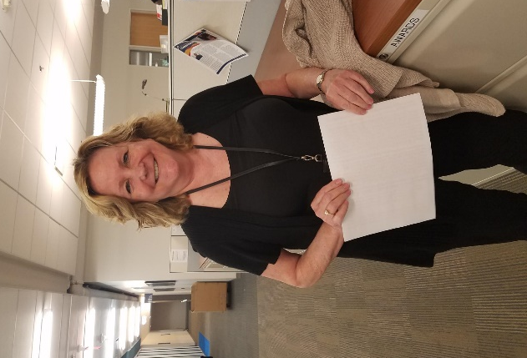
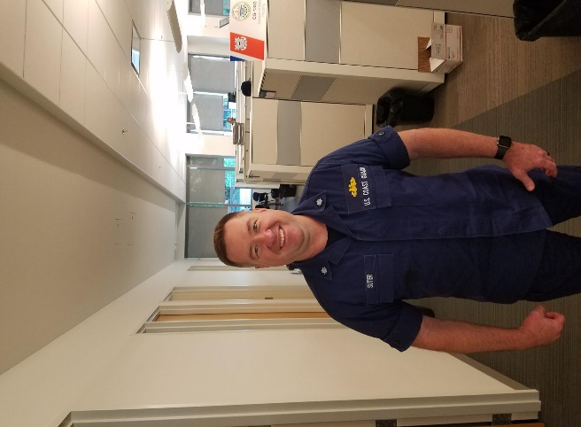
Military Personnel (CG-13)

Slide 8
Thank You!

